Slide 1
NLP Interview Preparation Using ChatGPT
Dec 7, 2023

Slide 2
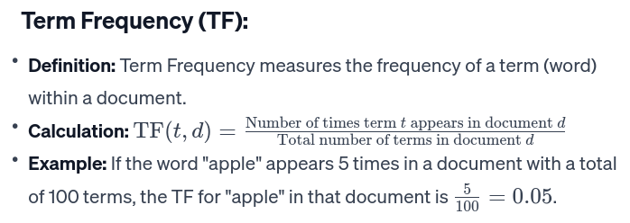
Please explain TF-IDF model.
TF-IDF, which stands for Term Frequency-Inverse Document Frequency, is a numerical statistic used in information retrieval and text mining to evaluate the importance of a word in a document relative to a collection of documents (corpus). TF-IDF combines two components: Term Frequency (TF) and Inverse Document Frequency (IDF).

Slide 3
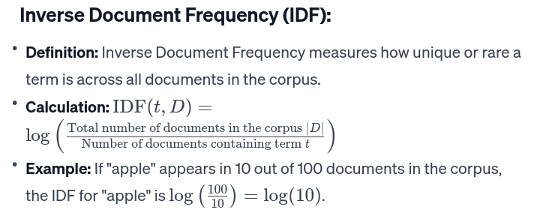

Slide 4
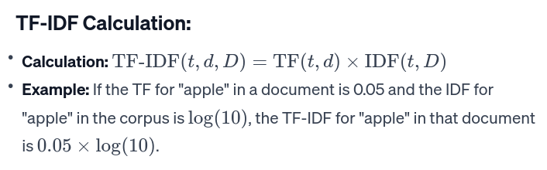

Slide 5
Key Points:
Higher Weight for Important Terms: Terms that are frequent in a document (high TF) but rare across the entire corpus (high IDF) receive higher TF-IDF scores. These terms are considered more important in distinguishing the document.
Lower Weight for Common Terms: Common terms that appear in many documents are penalized with lower TF-IDF scores, as they may not contribute as much to document distinctiveness.
Sparse Vector Representation: The TF-IDF scores for all terms in a document can be combined into a vector, resulting in a sparse vector representation where most entries are zero.
Applications: TF-IDF is used in information retrieval, document classification, clustering, and other text mining tasks to identify important terms in a document and improve the accuracy of text-based tasks.
TF-IDF is a powerful technique for representing and ranking the importance of terms in a document relative to a larger corpus, providing a way to capture the specificity and uniqueness of terms within the context of a collection of documents.

Slide 6
What is a word embedding?
A word embedding is a numerical representation of a word in a continuous vector space, where the position of each word is learned based on its linguistic context. Word embeddings are designed to capture semantic relationships between words, making them a fundamental component in natural language processing (NLP) and machine learning tasks involving textual data.
Key characteristics of word embeddings:
Continuous Vector Representation:
Unlike traditional one-hot encoding, where words are represented as sparse vectors with a single "1" and the rest as "0," word embeddings are dense vectors with real-valued numbers. Each dimension of the vector corresponds to a feature or aspect of the word's meaning.
Semantic Similarity:
Words with similar meanings are represented by vectors that are close together in the vector space. The distances and directions between word vectors reflect semantic relationships.
Contextual Information:
Word embeddings are learned from the context in which words appear in a given dataset. The idea is that words with similar meanings will have similar distributions of neighboring words in sentences.
Word2Vec, GloVe, and FastText:
Word embeddings are often generated using algorithms like Word2Vec, GloVe (Global Vectors for Word Representation), and FastText. These algorithms utilize neural networks or co-occurrence statistics to learn vector representations.

Slide 7
Pre-trained Embeddings:
Pre-trained word embeddings are models that have already been trained on large corpora and can be used in downstream tasks without further training. Examples include Word2Vec and GloVe embeddings.
Word Similarity and Analogy:
Word embeddings can capture word similarity and analogies. For example, in a well-trained embedding space, the vector for "king" minus the vector for "man" plus the vector for "woman" might be close to the vector for "queen."
Dimensionality:
The dimensionality of word embeddings is a hyperparameter that determines the size of the vector space. Common choices are between 50 and 300 dimensions.
Applications:
Word embeddings are used in a wide range of NLP tasks, including text classification, sentiment analysis, machine translation, information retrieval, and more. They are also employed in deep learning models as the input representation for textual data.
Word embeddings play a crucial role in transforming words into continuous numerical representations that capture semantic information, allowing models to better understand and generalize from textual data.

Slide 8
Explain Word2Vec
Word2Vec is a popular technique in natural language processing (NLP) that is used to learn distributed representations (word embeddings) of words in a continuous vector space. Developed by a team at Google, Word2Vec captures semantic relationships between words by representing them as dense vectors in a way that preserves their contextual similarities.
Key Concepts:
Distributed Representations:
Word2Vec represents words as vectors in a high-dimensional space, where the position of each word is learned based on its context in the training data.
Context and Similarity:
The underlying idea is that words appearing in similar contexts have similar meanings. Word2Vec captures this by learning vector representations in such a way that the distance and direction between vectors reflect the semantic relationships between words.
Skip-gram and Continuous Bag of Words (CBOW):
Word2Vec has two main architectures: Skip-gram and Continuous Bag of Words (CBOW). Skip-gram predicts the context words given a target word, while CBOW predicts the target word given its context. Both approaches aim to optimize the likelihood of predicting surrounding words based on the target word.
Neural Network Architecture:
Word2Vec is implemented as a shallow neural network with one hidden layer. The weights of the hidden layer are the word vectors. The network is trained to predict the surrounding words or target word, and during this process, the word vectors are adjusted to capture semantic relationships.
Training Process:
The training process involves feeding a large corpus of text into the Word2Vec model. The model learns to adjust the word vectors to maximize the likelihood of predicting context words given a target word (Skip-gram) or predicting the target word given its context (CBOW).

Slide 9
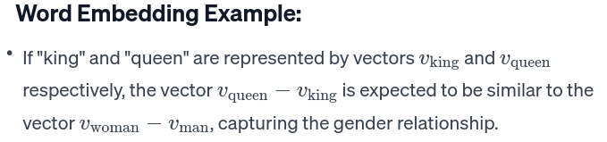
Word Similarity:
After training, words with similar meanings or contexts end up having similar vector representations. This property allows Word2Vec to capture semantic relationships, such as "king" and "queen" being close in vector space.
Dimensionality of Vectors:
The dimensionality of word vectors is a hyperparameter that can be tuned based on the specific task and dataset. Common choices are between 50 and 300 dimensions.
Applications:
Word2Vec embeddings have been widely used in various NLP tasks, including text classification, sentiment analysis, machine translation, and information retrieval. The pre-trained Word2Vec embeddings can also be used as features in downstream tasks.
Word2Vec has been influential in the development of more advanced word embeddings and has paved the way for powerful pre-trained models like GloVe (Global Vectors for Word Representation) and contextual embeddings like ELMo and BERT.

Slide 10
Explain GloVe.
GloVe, which stands for Global Vectors for Word Representation, is an unsupervised learning algorithm for obtaining word embeddings. Developed by researchers at Stanford University, GloVe aims to capture global statistical information about word co-occurrences in a corpus, enabling the generation of meaningful and contextually rich word vectors.
Key Characteristics and Concepts:
Global Co-occurrence Statistics:
GloVe is based on the idea that meaningful word representations can be derived from the global statistical information of word co-occurrences in a large corpus. It considers the overall word co-occurrence patterns rather than local context.

Slide 11
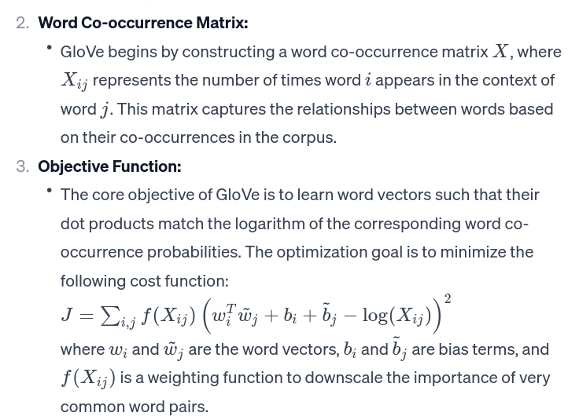

Slide 12
Training Process:
GloVe uses stochastic gradient descent to minimize the cost function. During training, word vectors are updated based on their ability to reconstruct the observed word co-occurrence probabilities.
Dimensionality:
The dimensionality of the word vectors in GloVe is a hyperparameter that can be adjusted based on the specific task and dataset. Common choices include 50, 100, 200, or 300 dimensions.
Pre-trained Embeddings:
Similar to Word2Vec, GloVe can be used to train word embeddings from scratch on a specific corpus, or pre-trained embeddings can be utilized for downstream tasks.
Applications:
GloVe embeddings are widely used in various NLP tasks, such as text classification, sentiment analysis, machine translation, and information retrieval. They provide dense, meaningful representations that capture semantic relationships between words.
GloVe has gained popularity for its ability to produce high-quality word embeddings by leveraging global co-occurrence statistics. It has been shown to be effective in capturing semantic relationships and has become a standard choice for word embedding generation in many NLP applications.

Slide 13
What is a Pre-trained language model?
A pre-trained language model is a model that has been trained on a large corpus of text data before being fine-tuned for a specific downstream natural language processing (NLP) task. These models are typically trained on massive amounts of diverse textual data to learn general language patterns, syntactic structures, and semantic relationships. Once pre-trained, these models can be fine-tuned on smaller, task-specific datasets for various NLP applications.
There are two main types of pre-trained language models:
Feature-Based Models:
These models learn fixed-size representations (features) for words or sub-word units. Examples include Word2Vec, GloVe, and FastText. These models generate embeddings for words based on contextual information but do not capture more complex syntactic or semantic structures.
Contextualized Models:
Contextualized language models, on the other hand, capture context-dependent representations for words. These models consider the surrounding context of each word in a sentence and generate embeddings that vary based on the context in which the word appears. Examples include ELMo (Embeddings from Language Models), GPT (Generative Pre-trained Transformer), and BERT (Bidirectional Encoder Representations from Transformers).

Slide 14
Pre-trained Language Models Workflow:
Pre-training:
The model is pre-trained on a large and diverse corpus of text. During pre-training, the model learns to predict missing words in a sentence or other related tasks. For example, BERT is pre-trained using a masked language model (MLM) objective, where some words are randomly masked, and the model is trained to predict these masked words based on the surrounding context.
Fine-tuning:
After pre-training, the model can be fine-tuned on smaller, task-specific datasets for various NLP applications. Fine-tuning adjusts the model's parameters to better suit the specific requirements of the downstream task, such as sentiment analysis, named entity recognition, or machine translation.
Transfer Learning:
The key advantage of pre-trained language models is transfer learning. By pre-training on a large and general dataset, the models learn useful language representations. Fine-tuning allows these models to adapt to specific tasks with relatively small amounts of task-specific data.

Slide 15
Benefits of Pre-trained Language Models:
Effective Transfer Learning:
Pre-trained models capture general language patterns, allowing for effective transfer learning to downstream tasks with limited labeled data.
Context-Aware Representations:
Contextualized models generate embeddings that take into account the surrounding context of each word, allowing them to capture more nuanced semantic relationships.
State-of-the-Art Performance:
Pre-trained language models have achieved state-of-the-art performance on various NLP benchmarks and competitions.
Reduced Need for Annotated Data:
Fine-tuning on task-specific data requires less annotated data compared to training models from scratch.
Examples of popular pre-trained language models include OpenAI's GPT-3, BERT (developed by Google), RoBERTa, and T5. These models have demonstrated remarkable success in a wide range of NLP tasks and have significantly contributed to advancements in natural language understanding.

Slide 16
Explain BERT.
BERT, which stands for Bidirectional Encoder Representations from Transformers, is a natural language processing (NLP) model developed by Google in 2018. It represents a significant advancement in the field of language understanding and has been widely adopted in various NLP applications.
Here are the key components and concepts associated with BERT:
Transformer Architecture: BERT is based on the transformer architecture, which was introduced by Vaswani et al. in the paper "Attention is All You Need." Transformers use self-attention mechanisms to process input data in parallel, making them highly efficient for handling sequential data like text.
Bidirectional Context: Unlike previous language models that processed text in a left-to-right or right-to-left manner, BERT considers the entire context of a word by using bidirectional context. This means that during training, BERT looks at both the left and right context of each word in a sentence, allowing it to capture richer semantic information.
Pre-training: BERT is pre-trained on large amounts of unlabeled text data. During pre-training, the model learns to predict missing words in a sentence by considering the surrounding context. This task is known as the Masked Language Model (MLM) objective, where certain words in a sentence are randomly masked, and the model is trained to predict those masked words.

Slide 17
Two-Stage Training: BERT follows a two-stage training process. In the pre-training stage, the model is trained on a massive corpus of text data. In the fine-tuning stage, the pre-trained model is further trained on a smaller dataset with labeled examples for specific NLP tasks, such as text classification, named entity recognition, question answering, etc.
Contextual Word Embeddings: BERT produces contextualized word embeddings, meaning that the embedding of a word can vary depending on its context within a sentence. This enables BERT to capture the nuances of word meanings in different contexts.
Application in NLP Tasks: BERT's pre-trained representations have been shown to be highly effective for a wide range of NLP tasks. By fine-tuning the pre-trained model on task-specific data, BERT can achieve state-of-the-art performance in tasks like sentiment analysis, named entity recognition, question answering, and more.
BERT Variants: Since the introduction of BERT, several variants and improvements have been proposed, including models like GPT-3, RoBERTa, and ALBERT, each with specific modifications to enhance performance or address certain limitations.
BERT has played a crucial role in advancing the capabilities of natural language processing models and has become a cornerstone in the development of various language understanding applications.

Slide 18
Explain GPT.
GPT, or Generative Pre-trained Transformer, is a series of natural language processing (NLP) models developed by OpenAI. The GPT models are based on the transformer architecture and are designed for a wide range of natural language understanding and generation tasks. As of my last knowledge update in January 2022, the latest version is GPT-3.
Here are the key features and concepts associated with GPT:
Transformer Architecture: GPT is built on the transformer architecture, which was introduced by Vaswani et al. in the paper "Attention is All You Need." The transformer architecture uses self-attention mechanisms to process input data in parallel, making it highly efficient for handling sequential data like text.
Pre-training: Similar to BERT, GPT models are pre-trained on large amounts of unlabeled text data. During pre-training, the model learns to predict the next word in a sentence given its context. This is known as the autoregressive language modeling objective.
Generative Approach: GPT is a generative model, meaning it is capable of generating coherent and contextually relevant text. Given a prompt or an initial sequence of text, GPT can continue generating text in a way that is contextually appropriate.
Layer-wise Training: GPT models have a layer-wise training approach, where each layer of the model is trained to understand different levels of context. This allows the model to capture hierarchical patterns and dependencies in the input data.
Attention Mechanism: The attention mechanism in transformers enables the model to focus on different parts of the input sequence when making predictions. This attention mechanism contributes to the model's ability to capture long-range dependencies in the data.

Slide 19
Large-Scale Models: GPT models, especially in later iterations like GPT-3, are characterized by their large number of parameters. GPT-3, for example, has 175 billion parameters, making it one of the largest language models to date. The large scale contributes to the model's ability to capture complex patterns and nuances in language.
Transfer Learning: GPT models are designed with a pre-training and fine-tuning paradigm. After pre-training on a large corpus of text data, the model can be fine-tuned on smaller, task-specific datasets for a variety of downstream NLP tasks, such as text completion, question answering, translation, and more.
Zero-Shot and Few-Shot Learning: GPT-3 introduced the capability of zero-shot and few-shot learning. This means the model can perform tasks with minimal task-specific training examples or even without any examples by providing a prompt or instruction.
GPT models have demonstrated state-of-the-art performance on a wide range of NLP benchmarks and tasks, showcasing the effectiveness of transformer-based architectures and large-scale pre-training for language understanding and generation.

